Slide 1

Object Oriented Design and Programming
Week 4
Version 2 – 18th December 2015

Slide 2
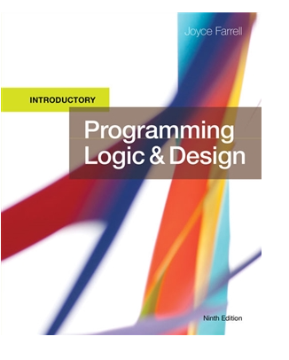
SLIDE TITLE
Farrell, J. (2017) Programming Logic and Design, Comprehensive (9th ed.) Cengage Learning

Slide 3
Programming Logic and Design Ninth Edition
Chapter 5
Understanding Programming Structures

Slide 4
Objectives
Programming Structure-Looping
While loop
Do-while loop
For loop
Combination of programming structures
Understanding the Reasons for Structure

Slide 5
The Loop Structure
Loop structure
Repeats a set of actions while a condition remains true
Loop body
Also called repetition or iteration
Condition is tested first in the most common form of loop
The while…do or while loop or for loop

Slide 6
The Loop Structure (continued -2)
Loop structure
while testCondition continues to be true
do someProcess
endwhile
while you continue to be hungry
take another bite of food
determine if you still feel hungry
endwhile

Slide 7
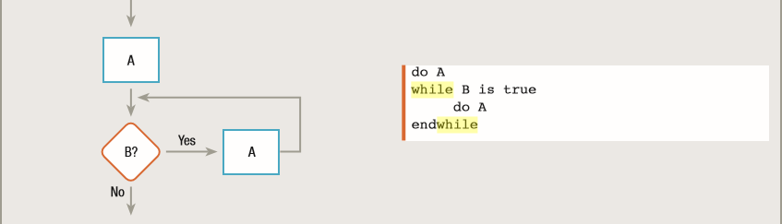
The Loop Structure (continued -3)
while loop
Ask a question and, depending on the answer, you might or might not enter the loop to execute the loop’s procedure.
A while loop is also called a pretest loop because a condition is tested before entering the loop even once.

Slide 8
The Loop Structure (continued -4)
while loop
The important point to note when using while loop:
Use increment or decrement statement inside while loop
Loop variable gets changed on each iteration
And at some point condition returns false
This way we can end the execution of while loop otherwise the loop would execute indefinitely.

Slide 9
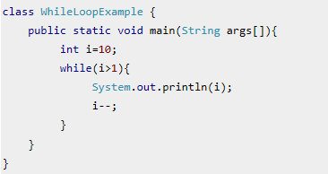
The Loop Structure (continued -5)
while loop in Java
Program to print 2-10 in reverse order using while loop
Loop starting point
Condition check
Decrement statement

Slide 10
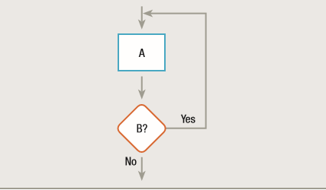
The Loop Structure (continued -6)
do-while loop
Ensure that the procedure executes at least once; then, depending on the answer to the controlling question, the loop may or may not execute additional times.
Do-while and do-until loops are also called post test loops because a condition is tested after the loop body has executed.

Slide 11
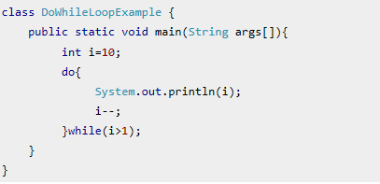
The Loop Structure (continued -7)
do-while loop in Java
Program to print 2-10 in reverse order using do-while loop
Loop starting point
Decrement statement
Condition check

Slide 12
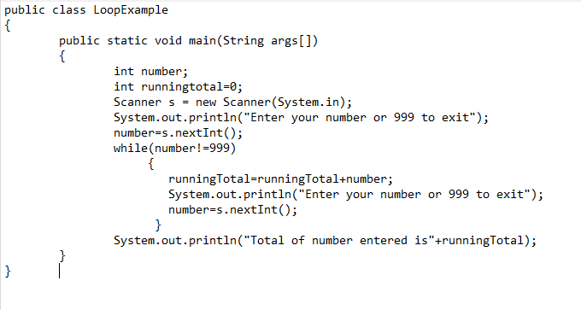
The Loop Structure (continued -7)
Finding sum of n numbers entered by user
You don’t know the exact number of inputs from user.
Use some sentinel value to end the program.

Slide 13
The Loop Structure (continued -8)
Loop structure
for( starting point , conditioncheck,increment/decrement)
Your statements here
Initialization happens first and only one time.
Condition in for loop is evaluated on each iteration.
if the condition is true then the statements inside for loop body gets executed.
Once the condition returns false, the statements in for loop does not execute
Control gets transferred to the next statement in the program after for loop.

Slide 14
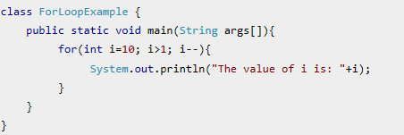
The Loop Structure (continued -9)
for loop in Java

Slide 15
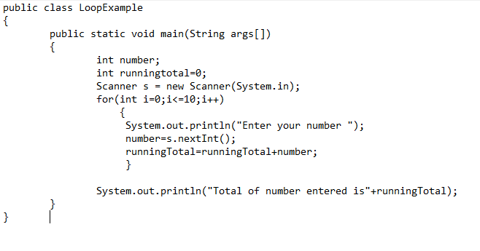
The Loop Structure (continued -7)
Finding sum of 10 numbers entered by user
You know the exact number of inputs from user.

Slide 16
The Loop Structure (continued -9)
Three loops have now been introduced the for, while and do-while
Use a for … loop
• If the number of repetitions can be determined prior to executing the loop i.e. it’s a counter controlled loop
Use a while … loop
• If the number of repetitions cannot be determined prior to executing AND
• Zero or more repetitions are possible
Use a do-while loop
• If the number of repetitions cannot be determined prior to executing AND
• One or more repetitions are possible
• This is a much rarer case than zero or more repetition

Slide 17
Combining Structures
All logic problems can be solved using only sequence, selection, and loop
Structures can be combined in an infinite number of ways
Stacking structures
Attaching structures end-to-end
End-structure statement
Indicates the end of a structure
The endif statement ends an if-then-else structure
The endwhile statement ends a loop structure

Slide 18
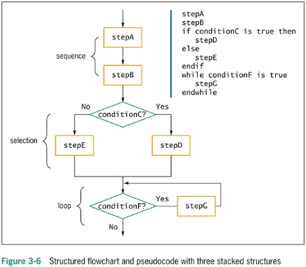
Combining Structures (continued -1)

Slide 19
Combining Structures (continued -2)
Any individual task or step in a structure can be replaced by a structure
Nesting structures
Placing one structure within another
Indent the nested structure’s statements
Block
A group of statements that execute as a single unit

Slide 20
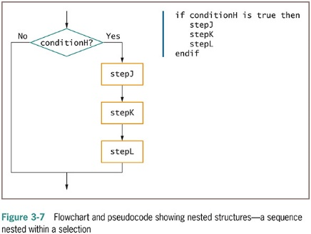
Combining Structures (continued -3)

Slide 21
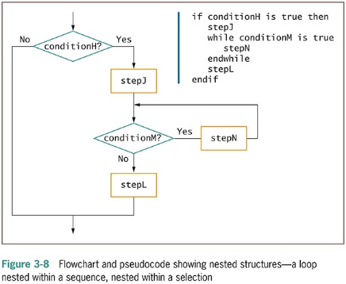
Combining Structures (continued -4)

Slide 22
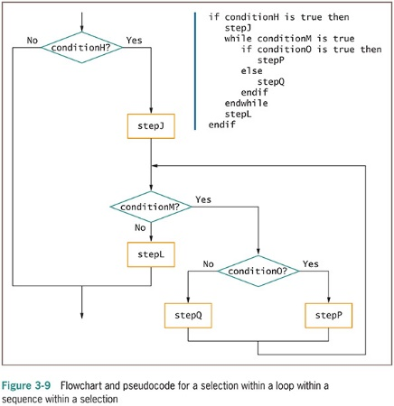
Combining Structures (continued -5)

Slide 23
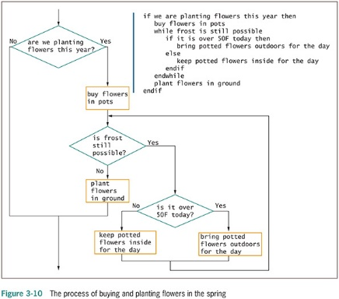
Combining Structures (continued -6)

Slide 24
Combining Structures (continued -7)
Structured programs have the following characteristics:
Include only combinations of the three basic structures
Each structure has a single entry point and a single exit point
Structures can be stacked or connected to one another only at their entry or exit points
Any structure can be nested within another structure

Slide 25
Understanding the Reasons for Structure
Use structured programming for:
Clarity—unstructured programs are confusing
Professionalism—other programmers expect it
Efficiency—most languages support it
Maintenance —other programmers find it easier to read
Modularity —easily broken down into modules
Structured programming is sometimes called goto-less programming

Slide 26
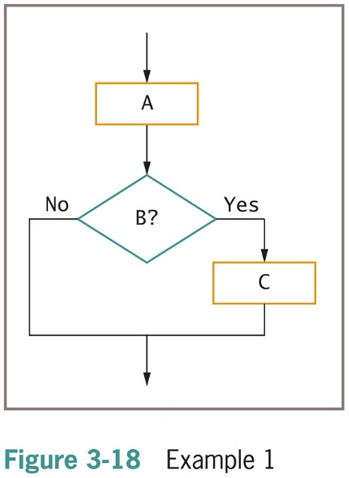
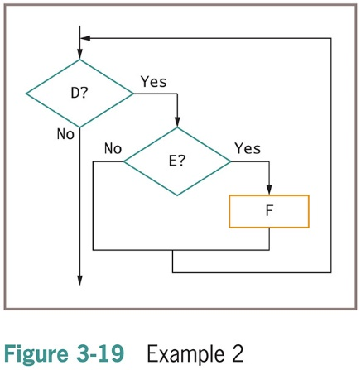
Recognizing Structure

Slide 27
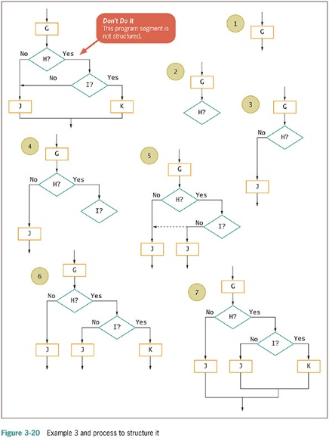
Recognizing Structure (continued -1)

Slide 28
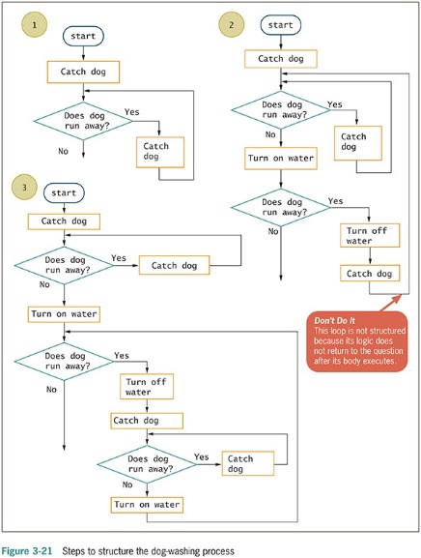
Recognizing Structure (continued -2)

Slide 29
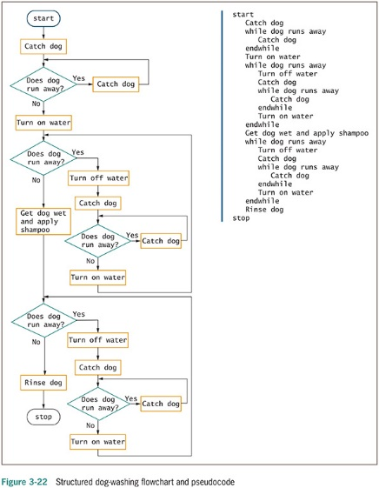
Recognizing Structure (continued -3)

Slide 30
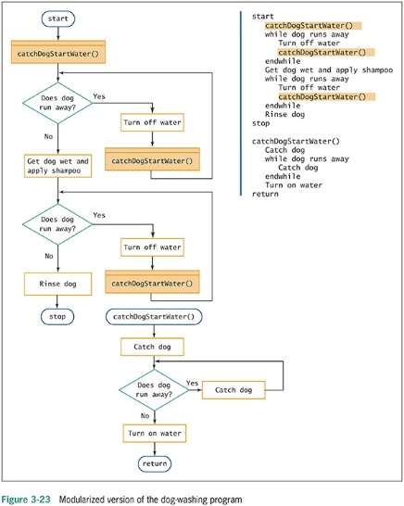
Recognizing Structure (continued -4)

Slide 31
Summary
Three loops
While loop is a pretest loop. Use it if the number of repetitions cannot be determined prior to executing
Do-while loop is post test loops. If the number of repetitions cannot be determined prior to executing AND One or more repetitions are possible
For loop is counter controlled loop. Use it if the number of repetitions can be determined prior to executing the loop

Slide 32
Summary (continued)
Structured techniques promote:
Clarity
Professionalism
Efficiency
Modularity
Logical steps can be rewritten to conform to the three structures: sequence, selection, and loops

Slide 33

kent.edu.au Kent Institute Australia Pty. Ltd. ABN 49 003 577 302 ● CRICOS Code: 00161E ● RTO Code: 90458 ● TEQSA Provider Number: PRV12051

